Slide 1


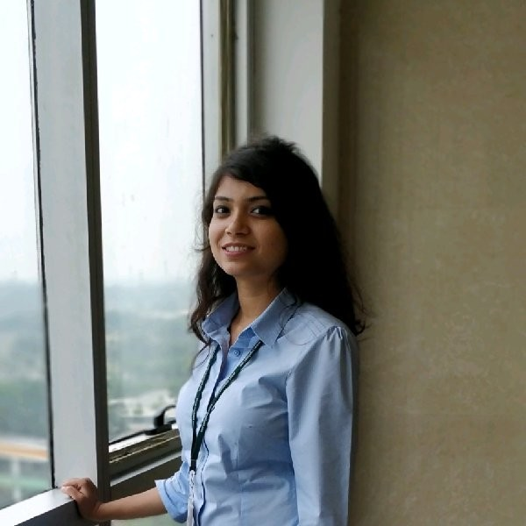
Medium Stories- Analysis and Predictions
Tech Elves
Devashish Nyati
Sweety Sojrani
Sweta Kumari

Slide 2
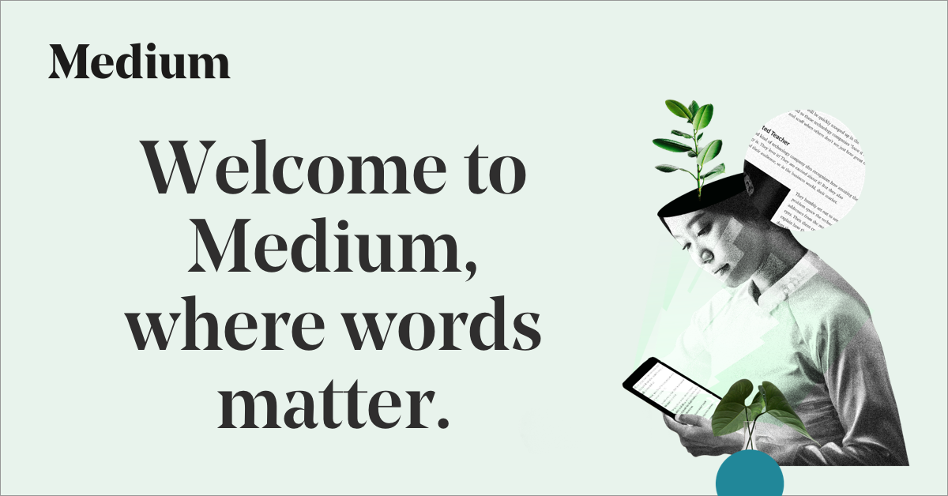
Overview
Medium is one of the best places for worlds most insightful writers, masterminds, and storytellers to present the smartest takes on topics that matter. One can always find fresh thinking and unique perspectives on Medium.
The scope of our project is to help users write effective posts and give insights about a post before even publishing it.

Slide 3
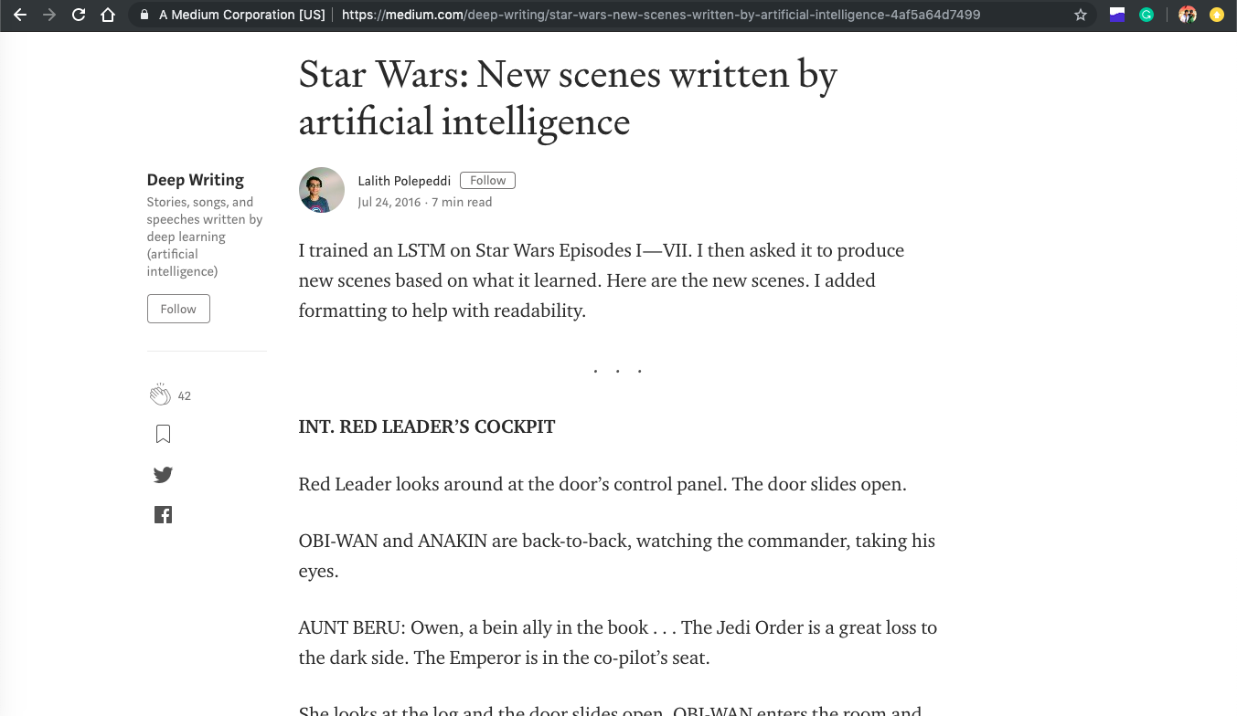

Slide 4
Dataset
There are 280K medium articles tagged as tagged AI, Machine Learning, Data Science or Artificial Intelligence. Each article has 132 columns.
postId : Unique identifier of the post
text : Content of the post
wordCount : Number of words in the post
Title : Title of the post
readingTime : What is the time taken on average to read this article
totalClapCount : Number of claps associated with the post
etc

Slide 5

Goal 1
Assisting Users to Write Effective Articles

Slide 6
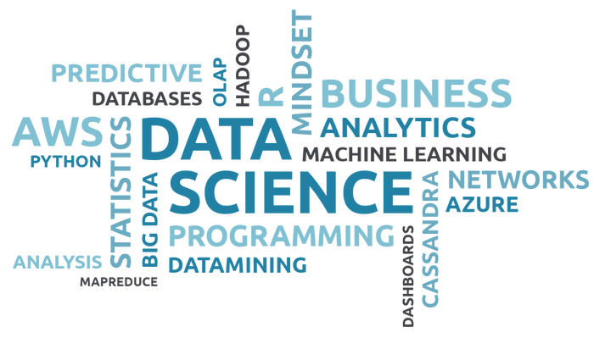
Goal 2
Help Users to Generate Tags

Slide 7
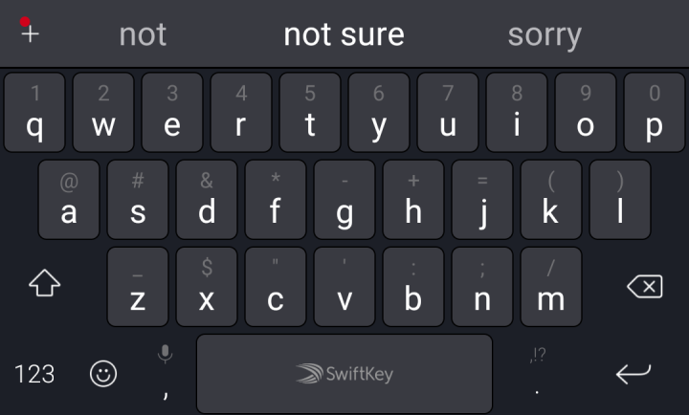
Goal 3
Predictive Keyboard for Writing Articles

Slide 8

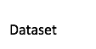
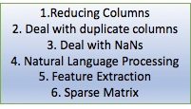
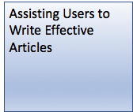
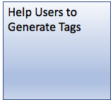

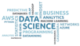
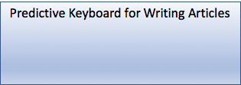
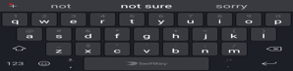
Architecture

Slide 9
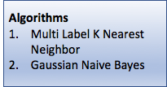
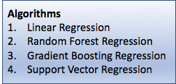
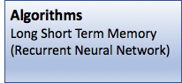
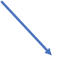

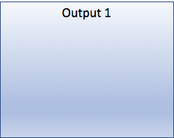
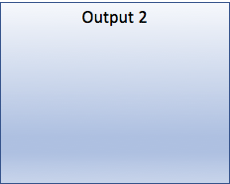

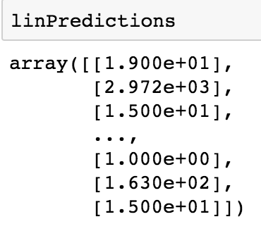
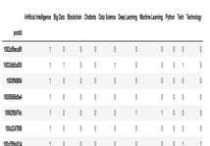
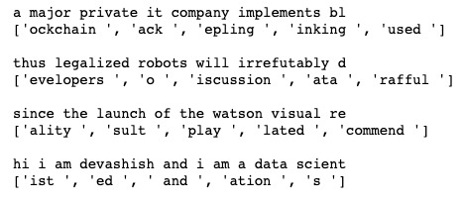
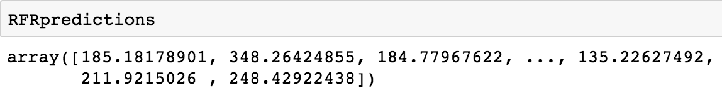
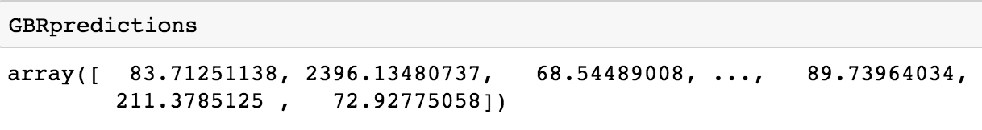
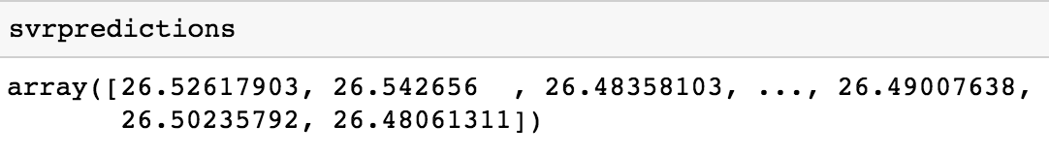

Slide 10


1. Analysing Data
Word Cloud
Word Frequency
Tag Pie Chart
Word Frequency

Slide 11
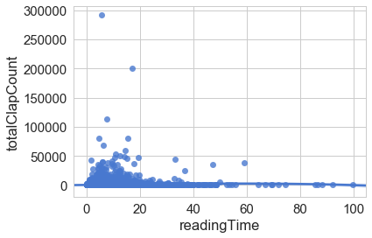
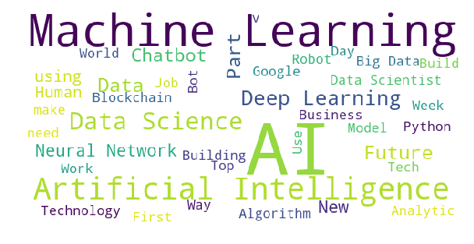
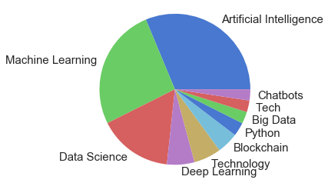
Data Visualization
Reading Time vs Clap Count
Tag Word Cloud
Tag Pie Chart

Slide 12
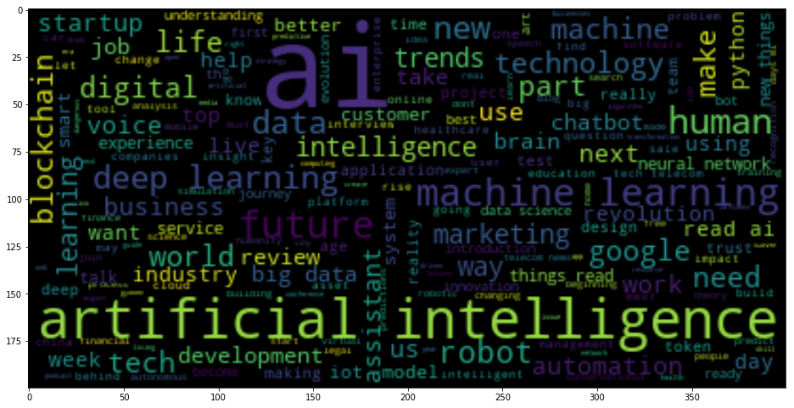
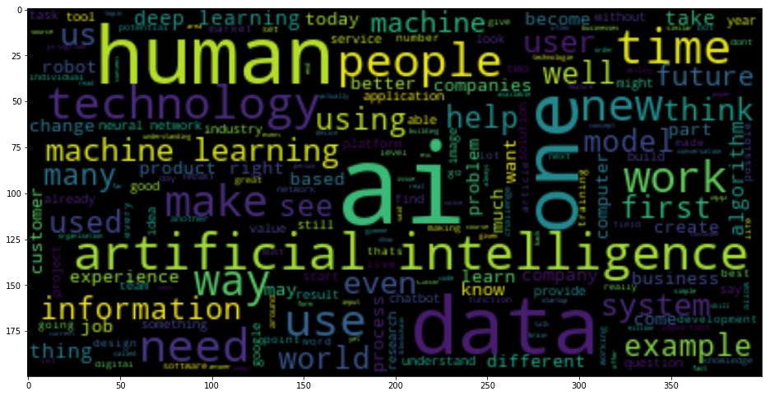
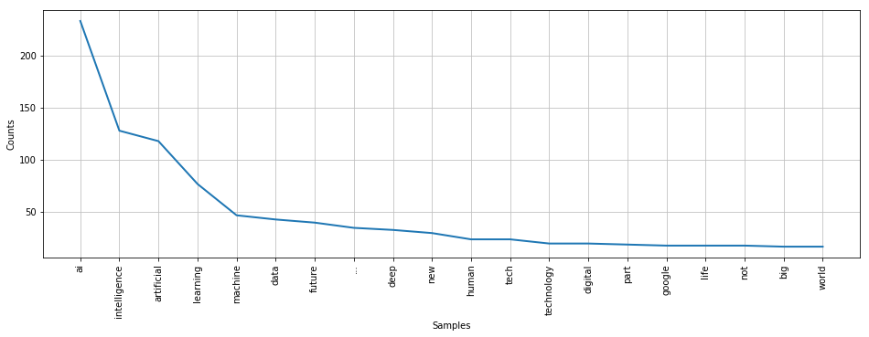
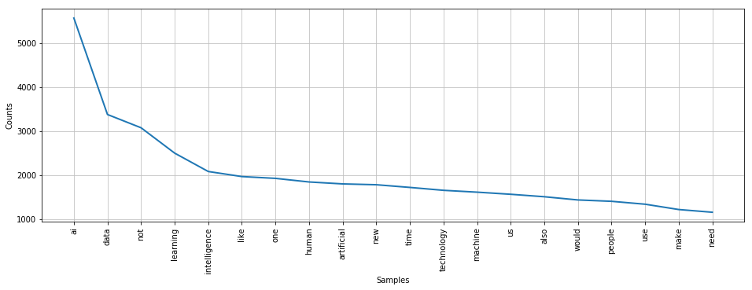
Text
Title

Slide 13
2. Data Preprocessing
Reducing Columns
Dealing with Duplicate Rows
Dealing with NaNs
Selecting Language
Creating Article Corpus
NLP
Feature Extraction
Splitting Strings to Columns
Get Dummies

Slide 14
3. Algorithms Used
Clap Prediction (Regression)
Linear Regression, Random Forest Regressor, Gradient Boosting Regressor, Support Vector Regressor
Tag Prediction (Classification)
Multi Label K Nearest Neighbour, Gaussian Naive Bayes
Word Prediction (Classification)
Long Short Term Memory (Recurrent Neural Network)

Slide 15
4. Evaluation
Clap Prediction (Regression)
RMSE, R^2
Tag Prediction (Classification)
Accuracy Score, Confusion Matrix
Word Prediction (Classification)
Accuracy Score

Slide 16
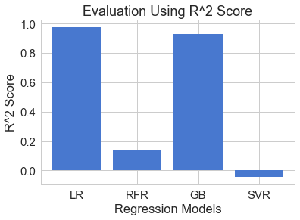
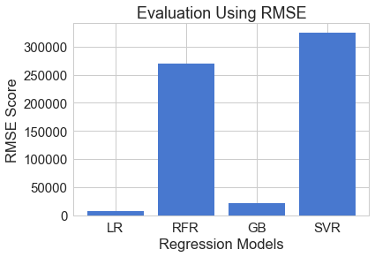
Evaluation- Clap Prediction

Slide 17
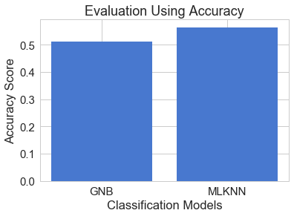
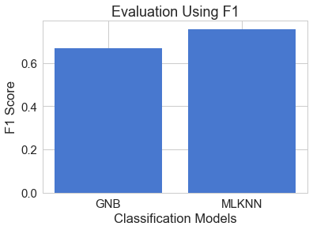
Evaluation- Tag Prediction

Slide 18
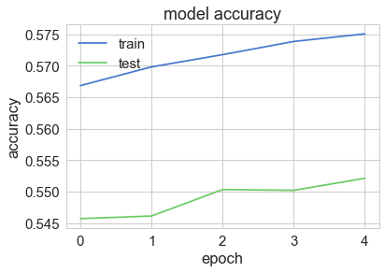

Evaluation- Word Prediction

Slide 19

Thank you!
Question?

